Slide 1
452 Numerical Weather Prediction
2024

Slide 2
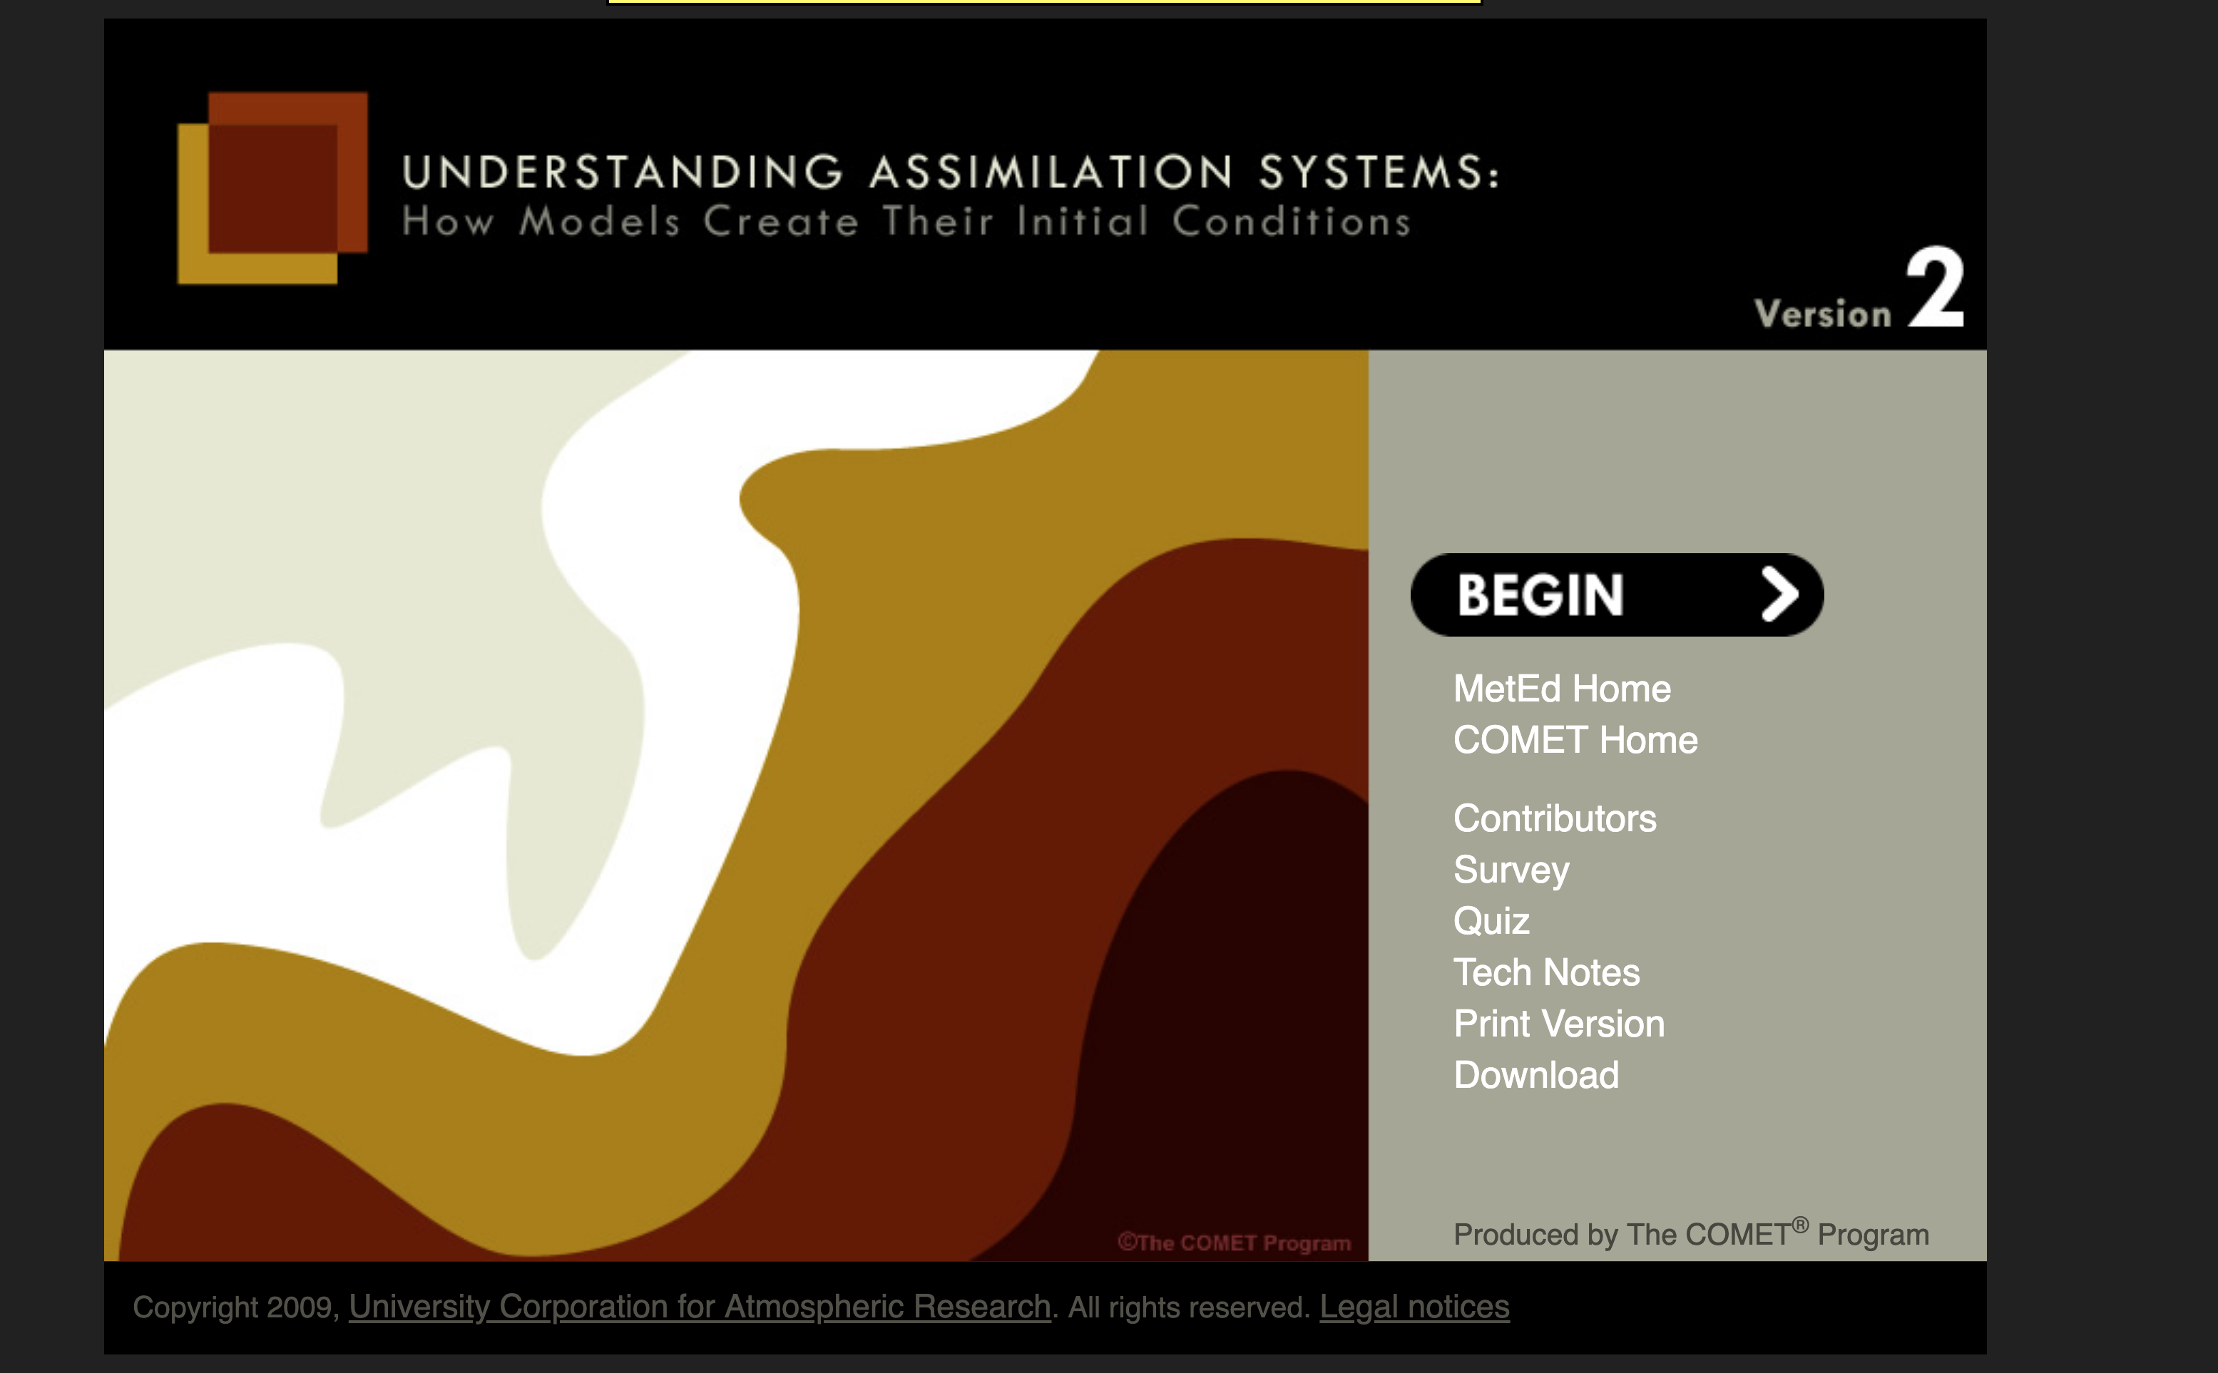
Assignment
COMET METED Module

Slide 3
Major Steps in the NWP Forecast Process
Data Collection
Quality Control
Data Assimilation
Model Integration
Post Processing of Model Forecasts
Product and graphics generation

Slide 4
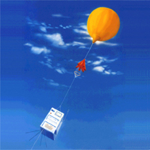
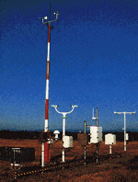
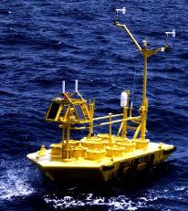

Observation and Data Collection

Slide 5
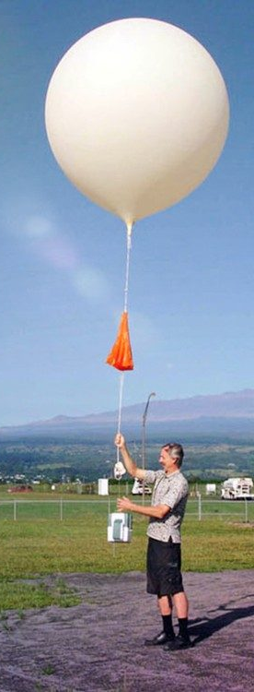
Data Collection
Weather observations are made throughout the world and the data is distributed in real time.
Many types of data and networks, including:
  Surface observations from many sources
  Radiosondes and radar profilers
  Fixed and drifting buoys
  Ship observations
  Aircraft observations
  Satellite soundings
  Cloud and water vapor track winds
  Radar and satellite imagery

Slide 6
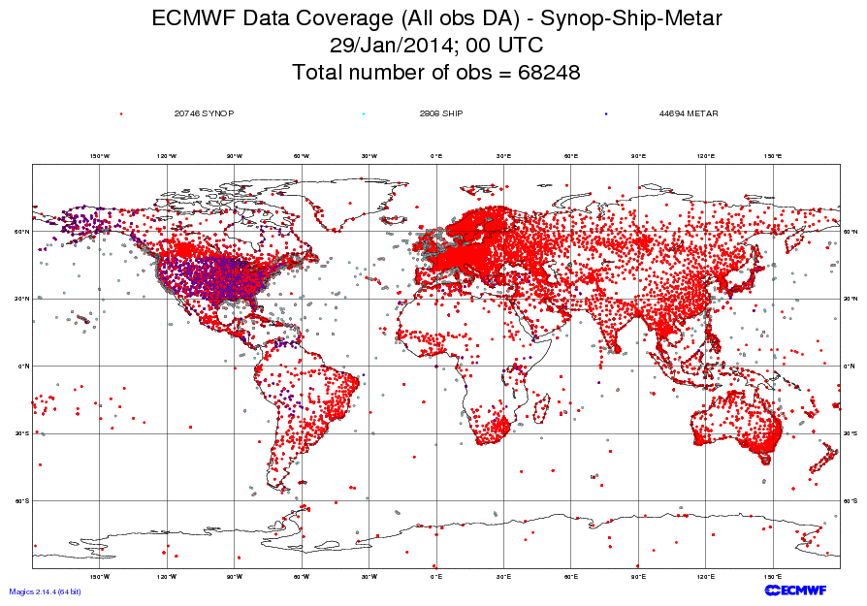

Slide 7
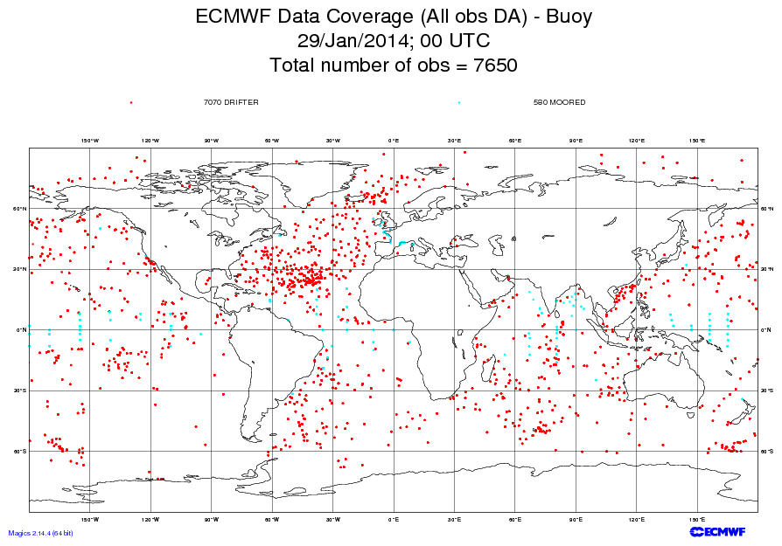

Slide 8
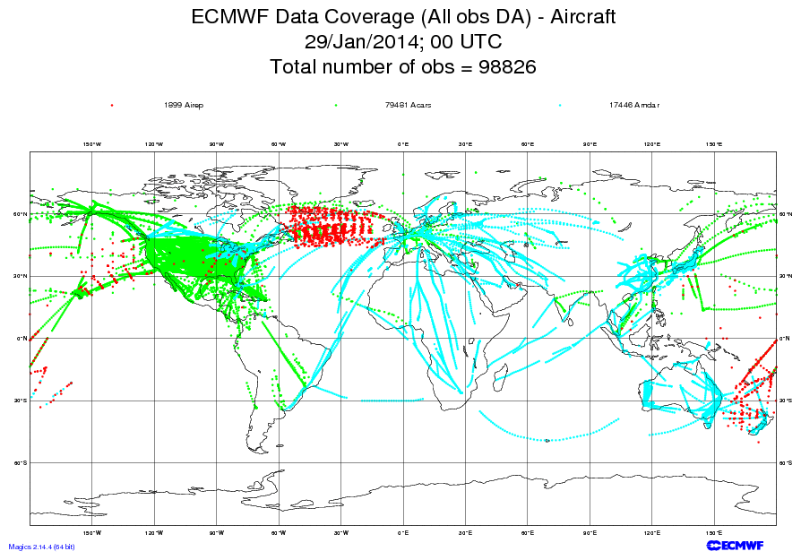

Slide 9
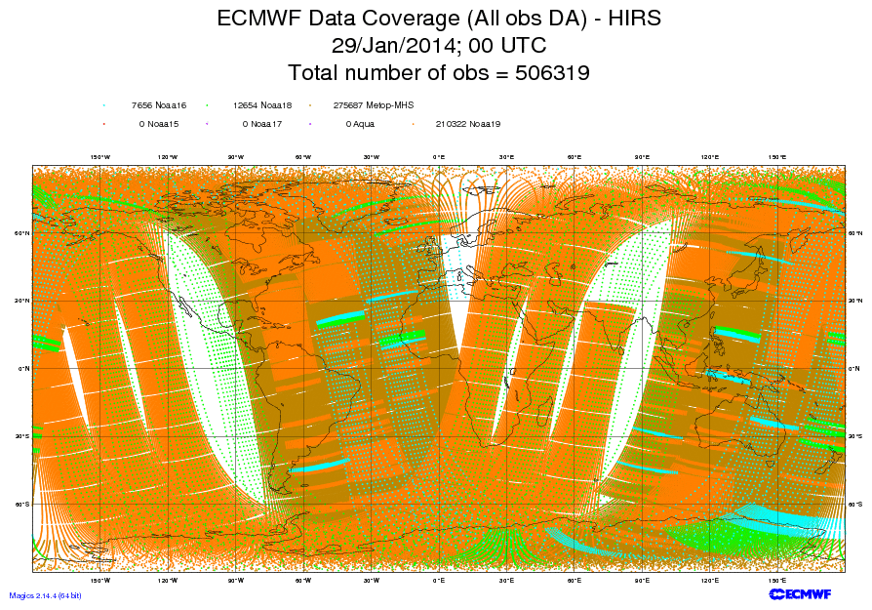
High-resolution Infrared Radiation Sounder

Slide 10
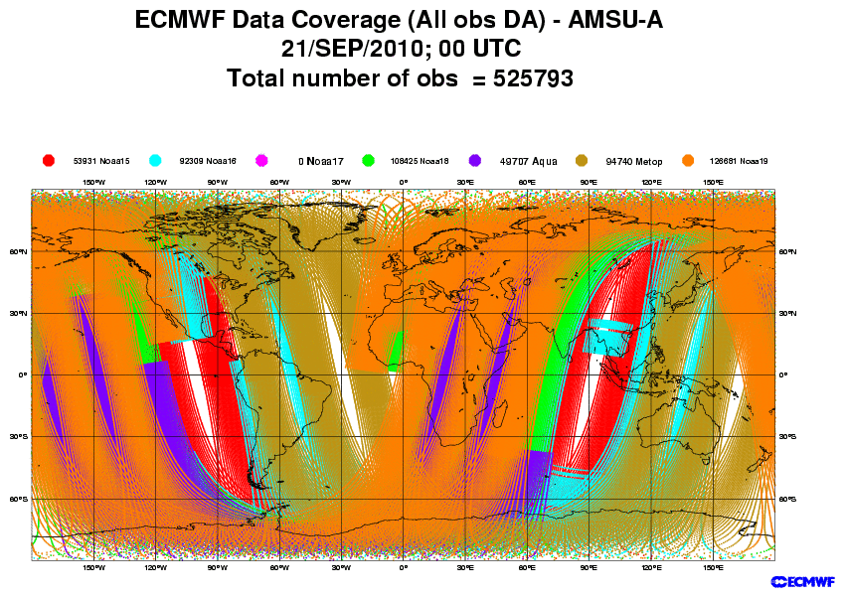
Microwave Sounder

Slide 11
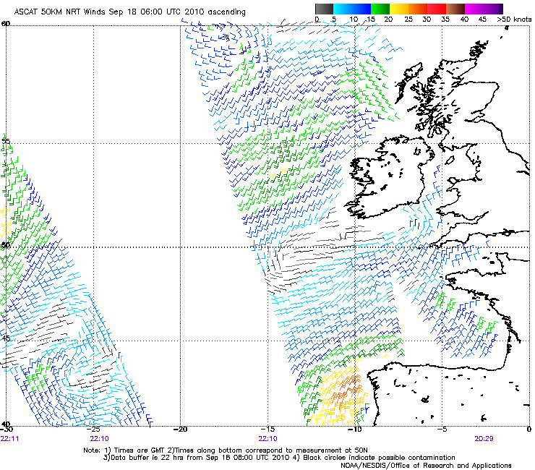
Scatterometer Winds

Slide 12
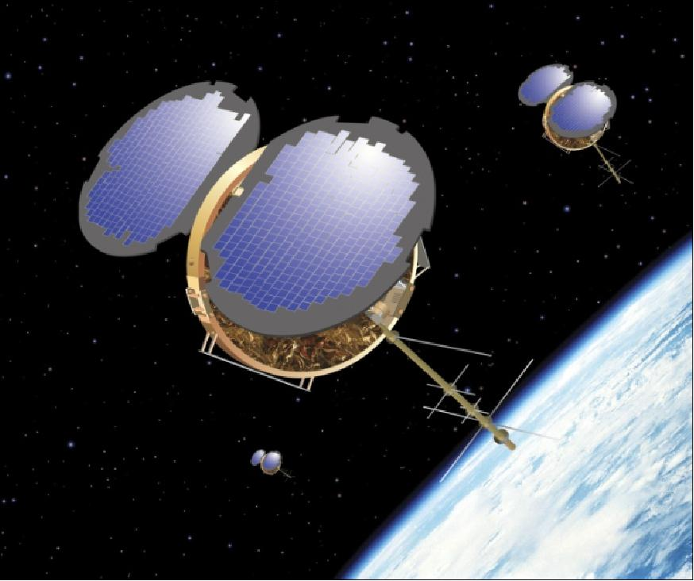
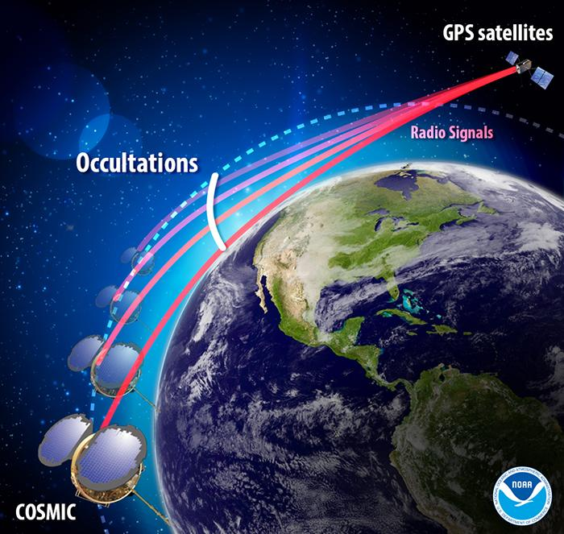
RO Satellites: e.g., COSMIC

Slide 13
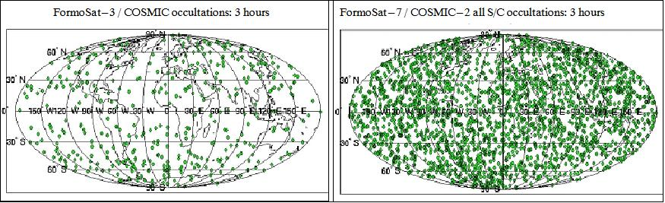

Slide 14


Slide 15
Weather Satellites Now Provide 99% of the Data Assets Used for NWP
Geostationary Satellites: Imagery, soundings, cloud and water vapor winds
Polar Orbiter Satellites: Imagery, soundings, many wavelengths
RO (GPS) satellites
Scatterometers
Active radars in space (GPM)

Slide 16
Quality Control
Automated algorithms and manual intervention to detect, correct, and remove errors in observations.
Examples:
  Range check
  Buddy check
  Comparison to first guess fields from previous model run
  Hydrostatic and vertical consistency checks for soundings.
A very important issue for a forecaster--sometimes good data is rejected and vice versa.

Slide 17
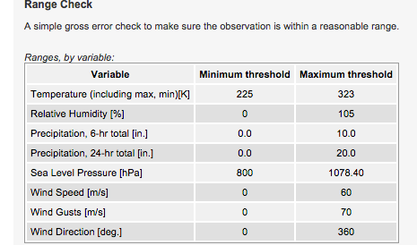
Range Check

Slide 18
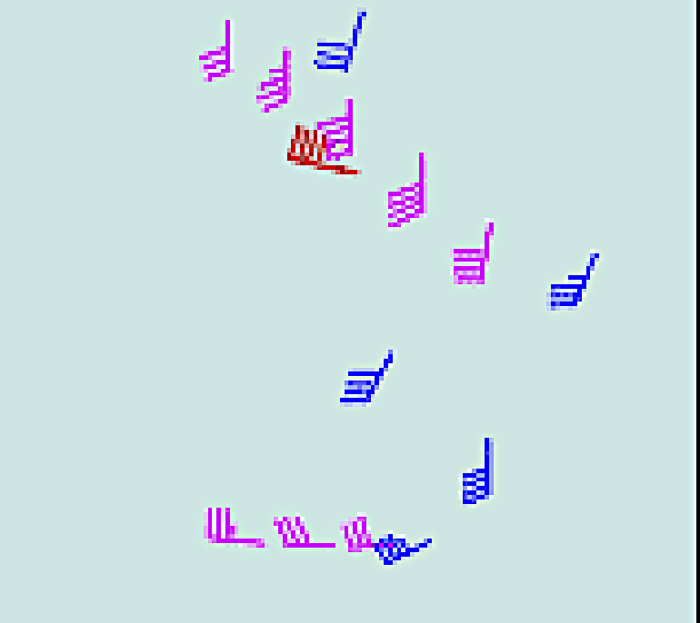
Buddy Check
Compare observations to those in the vicinity
If too different, reject.

Slide 19
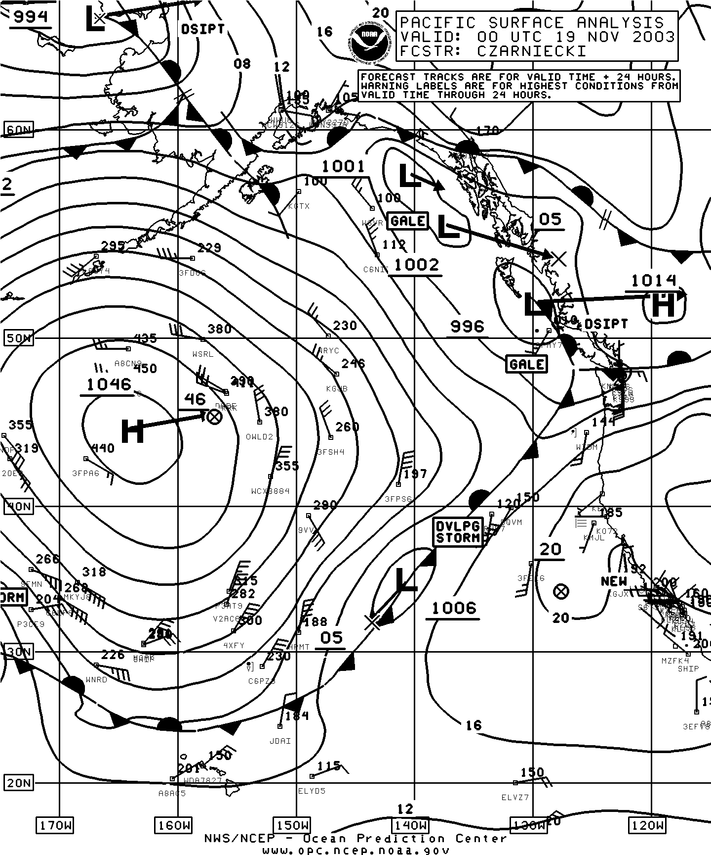
Pacific Analysis
At 4 PM
18 November
2003
Bad Observation
Buddy Check
Would Reject

Slide 20
Comparison to first guess fields from previous model run
The first guess is usually a short-term forecast from the previous run (e.g., 6 hours old)
This forecast SHOULD be quite good.
A large difference with an observation suggests a problem. Such observations are flagged.
But there are DANGERS….what if the first guess is wrong?…could reject good data.

Slide 21
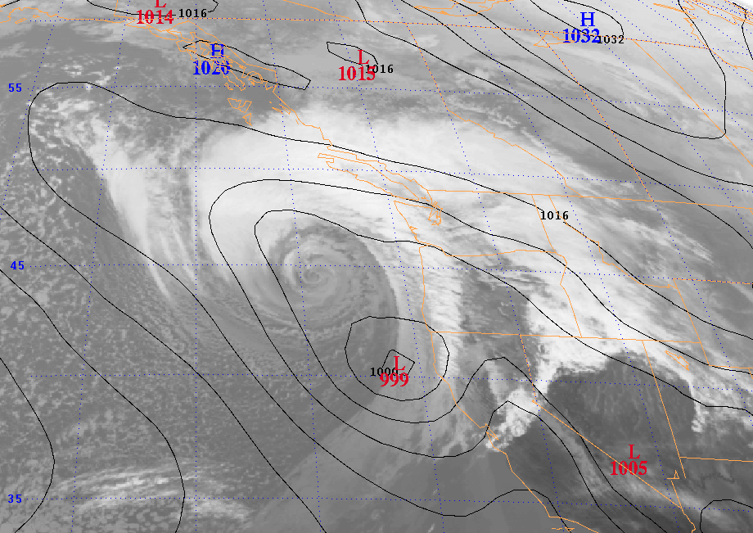
This HAS Happened
Eta 48 hr SLP Forecast valid 00 UTC 3 March 1999

Slide 22
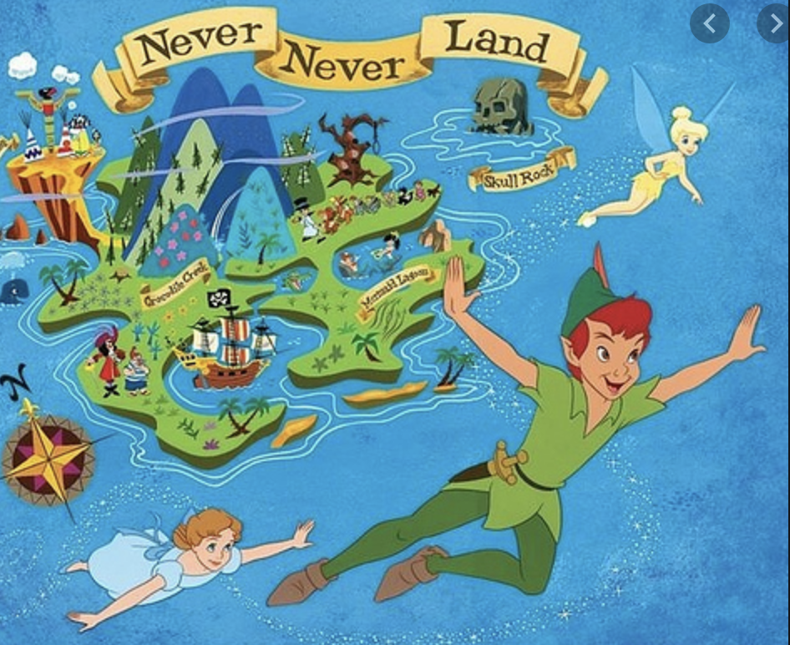
Dangers
If the first guess forecast is wrong, good data can be rejected
Allowing the bad forecast to be maintained.
Less of a problem today because we have so much data.

Slide 23
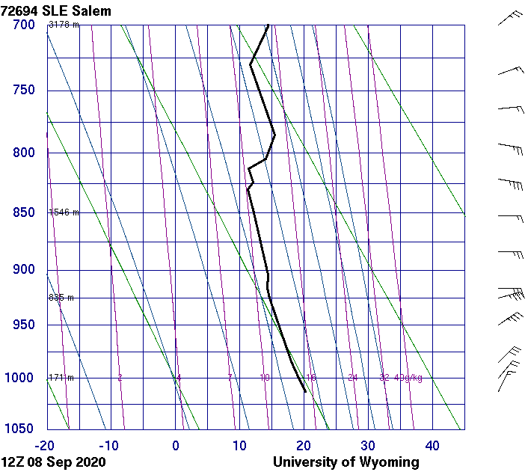
Hydrostatic and vertical consistency checks
Examine soundings to check for hydrostatic balance.
Atmospheric is generally hydrostatic. So reject if hydrostatic balance is violated.
Look for unrealistic hyper-gradients in the vertical. Reject such soundings.

Slide 24
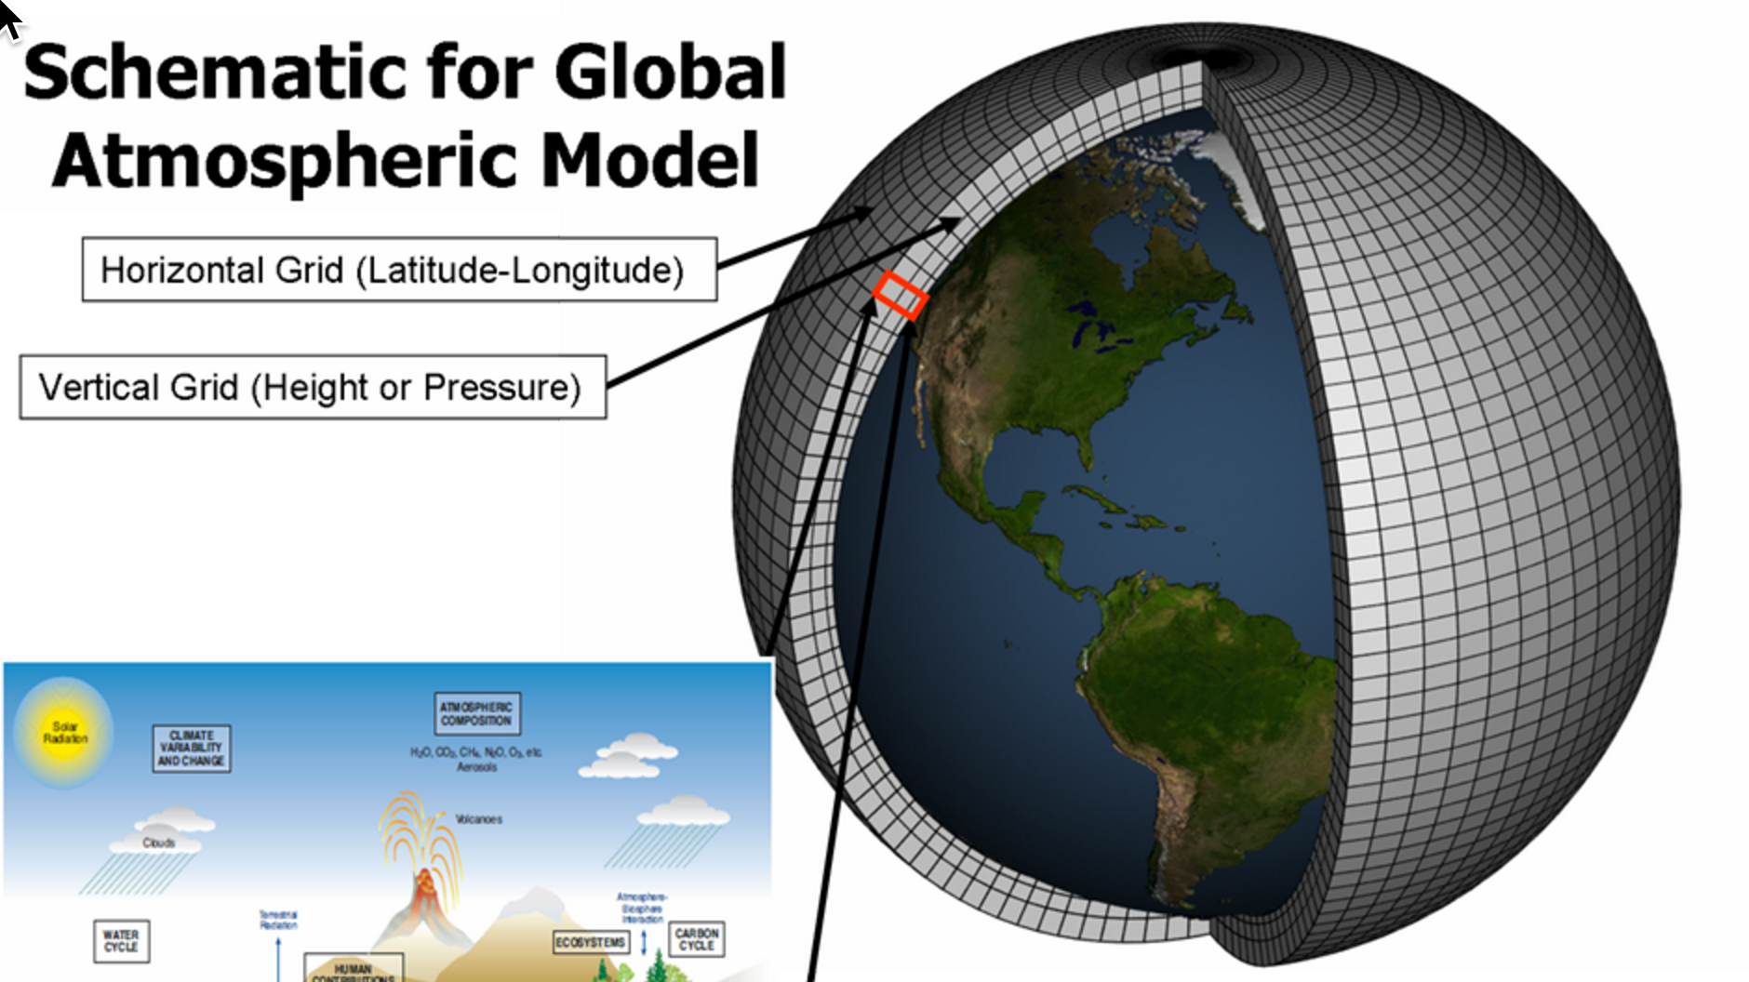
Objective Analysis/Data Assimilation
Observations are scattered in three dimensions
Numerical weather models are generally solved on a three-dimensional grid
Need to interpolate observations to grid points and to ensure that the various fields are physically plausible
(e.g., most of the atmosphere in hydrostatic and gradient wind balance).

Slide 25
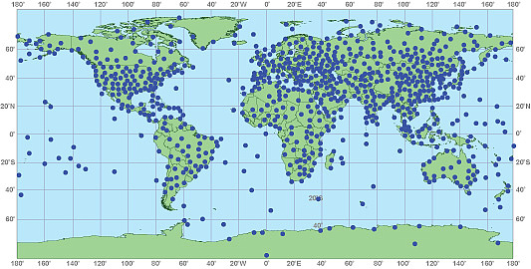
Observations are not on a regular grid

Slide 26
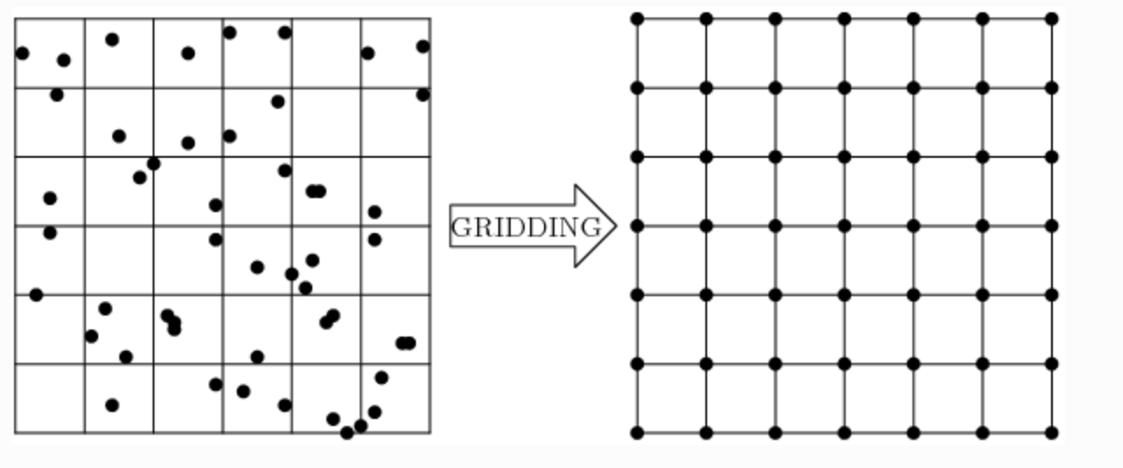
Objective Analysis/Data Assimilation
STEP 1
Interpolate of observational data to a grid

Slide 27
Objective Analysis/Data Assimilation
Often starts with a “first guess”, usually the gridded forecast from an earlier run (frequently a run starting 6 hr earlier)
This gridded first guess is then modified by the observations.
Adjustments are made to ensure proper balance. (e.g., hydrostatic)
Often iterative

Slide 28
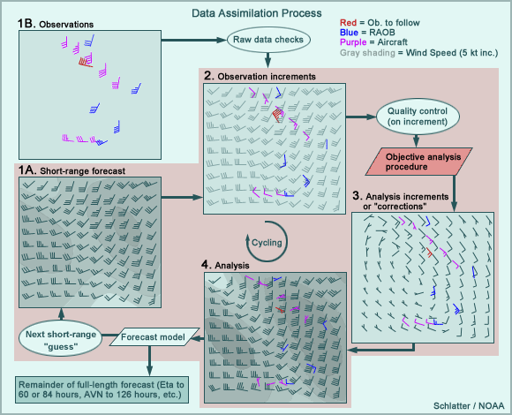
Observation increments are the differences of observations from first guess

Slide 29
An early objective analysis scheme is the Cressman scheme

Slide 30
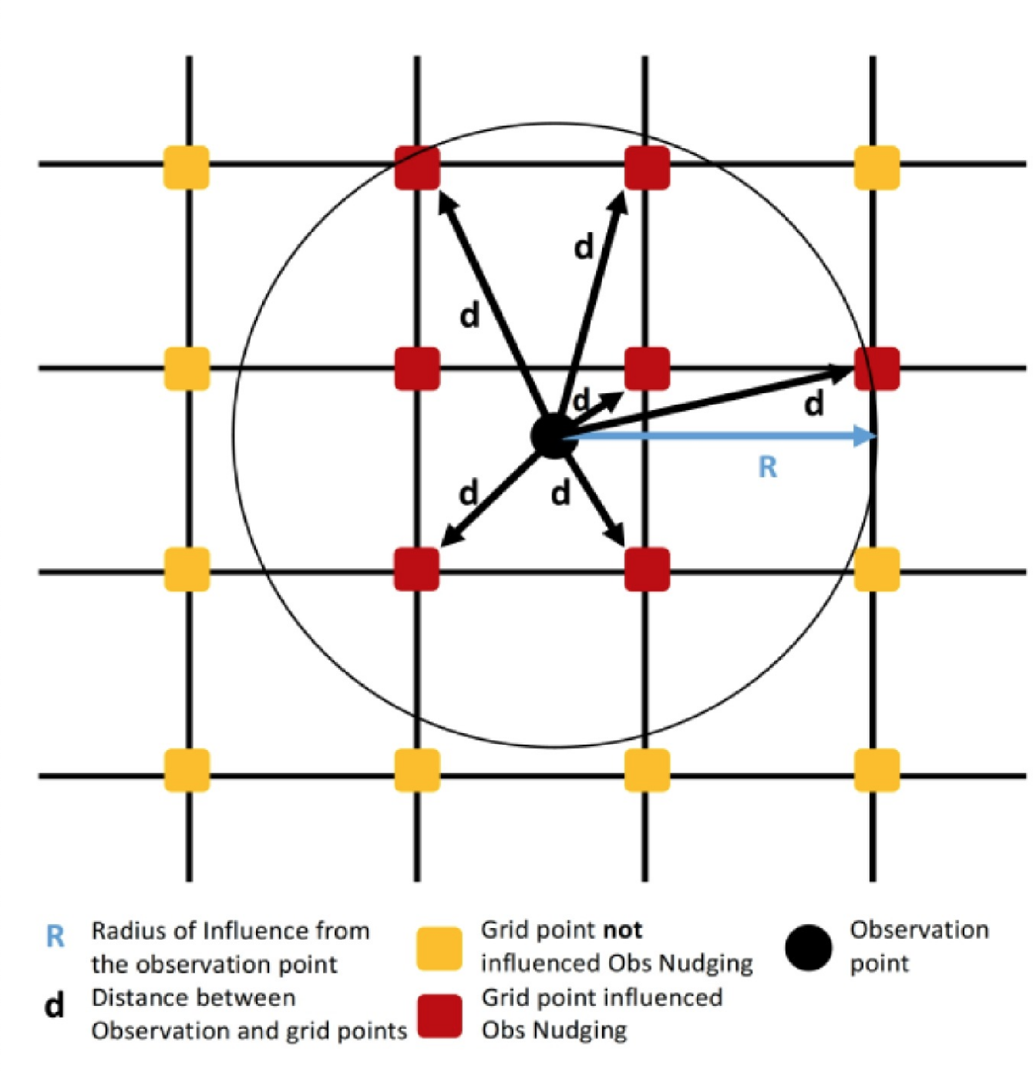
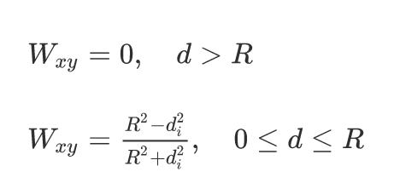
R is the radius of
influence of the observation

Slide 31
Cressman Scheme
Consider a variable (e.g., 500 hPa heights)
Start with large R
Modify values at grid points around observation using distance-related weights
Now go through all observations.

Slide 32
Cressman Scheme
Reduce R (only consider closer grid points around the observation.
Go through observations adjusting grid values
Reduce R
And again and again.

Slide 33
Cressman Scheme
Each grid point will be most modified by the closest observations
This is an example of a univariate (one variable) objective analysis scheme.
Can be extended to 3 dimensions

Slide 34
The Cressman Scheme Was Used in the 50s, 60s, and 70s
We can do better!

Slide 35
3DVAR: 3D Variational Data Assimilation
Used by the National Weather Service for the GFS and NAM
Called Gridpoint Statistical Interpolation (GSI).
Tries to create an analysis that minimizes a cost function dependent on the difference between the analysis and (1) first guess and (2) observations
Does this at a single time.

Slide 36
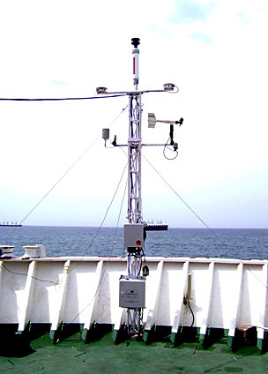
Neither the Observations nor Model First Guesses Are Perfect: They Both have errors
Need to weigh them based on their quality
For the first guess, quality depends on many factors (region, time of year, time of day, weather regime)
Observations quality vary (e.g. ASOS good, ship reports bad)

Slide 37
3DVAR Cost Function (CF)
CF = Σw_{o}(O-A)² + Σw_{f} (F-A)²
all obs All fields and grid points
O observations
A analysis
F first guess
w_{o} weight for observation
w_{f} weight for first guess

Slide 38
3DVAR Cost Function (CF)
CF = Σw_{o}(O-A)² + Σw_{f}(F-A)²
all obs All fields and grid points
Can iteratively (many times) modify the gridded analysis to reduce the cost function (we are trying to minimize difference with observations and forecasts)

Slide 39
But observations are not everywhere!
How do we modify the analysis away from observation locations?
Answer: use spatial covariance statistics to spatially spread the corrections based on observations (the corrections are also known as innovations)
Covariances relates the strength of relationship between values at one location and another for some variable.

Slide 40
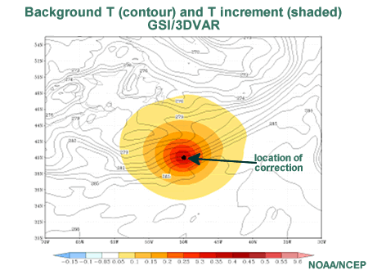
Traditionally, the covariances were circular, but other shapes have been used

Slide 41
More Recently More Complex Covariance Structures Have Been Used
Temperature observation
More Physical
Circular

Slide 42
3DVAR Review
We iteratively modify the analysis to reduce the cost function so that all grid points are as close as possible to observations and the first guess
Only as good as the first guess, quality of observations, and the covariance assumptions.
Does not consider consistency in time

Slide 43
How do we create analysis that match the EVOLUTION of the real atmosphere, not just what is happening at one time?
?

Slide 44
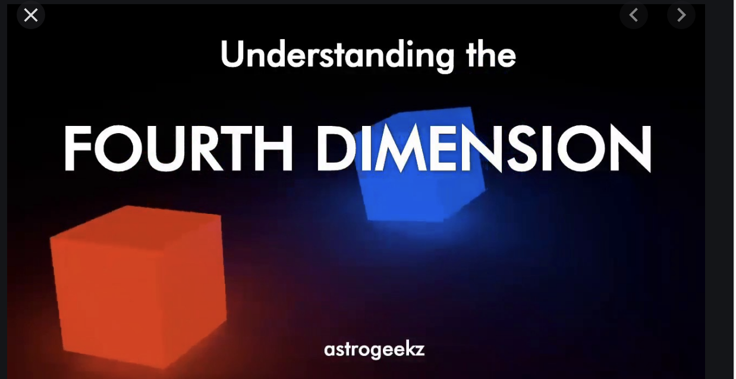
4DVAR: Used by ECMWF, UKMET, CMC

Slide 45
4DVAR: Four Dimension Variational Data Assimilation
Tries to optimize analyses at MULTIPLE TIMES
Tries to duplicate the observed evolution over time as well as the situation at a single (initialization) time.
Uses the model itself as a data assimilation tool.

Slide 46
4DVAR
Data Assimilation Period
OBS
OBS
OBS
Data Assimilation Period
Forecast
Earlier model forecast
-12h
-6h
0 Hr
Initialization

Slide 47
4DVAR Cost Function (CF)
CF = Σw_{o}(O-A)² + Σw_{f}(F-A)²
all obs/all times All fields, grid points, all times
O observations
A analysis
F first guess
w_{o} weight for observation
w_{f} weight for first guess
All times includes all times during the assimilation period

Slide 48
4DVAR Components
This is complex!
Full non-linear model (e.g., WRF, GFS)
Tangent linear version of the full model (linearized version of the forecast model)
Adjoint of the tangent linear model -which allows one to integrate the model backwards. Tells sensitivity of forecast to the initialization.

Slide 49
4DVAR
Data Assimilation Period
OBS
OBS
OBS
Full Non-Linear Model
Data Assimilation Period
Forecast
Linearized Adjoint Model
-12h
-6h
0 Hr
Initialization

Slide 50
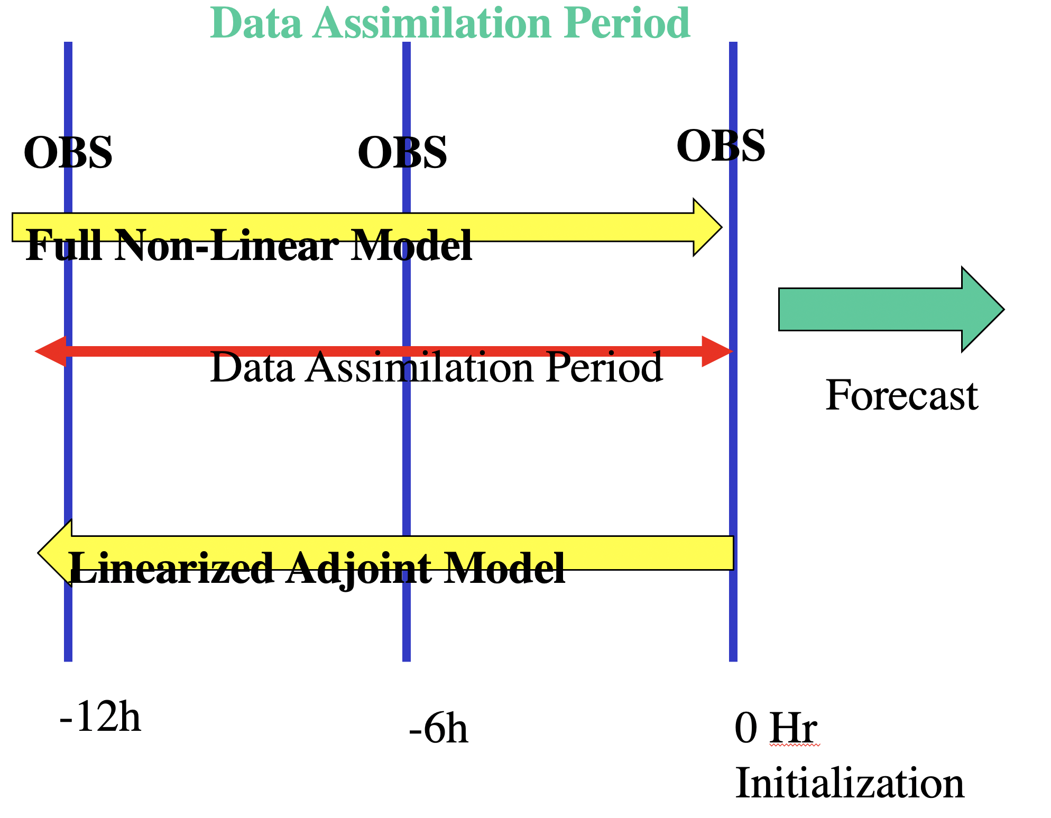
How 4DVAR works
Complete full model run from -12h to 0 hr
Note errors at -6 and 0 hr
Using adjoint, determine modifications at -12 that would improve forecast at -6 and 0hr
Run forward again, noting errors at -6 and 0hr
Run backward against to find adjustments at -12h that will improve things

Slide 51
4DVAR
Data Assimilation Period
OBS
OBS
OBS
Full Non-Linear Model
Data Assimilation Period
Forecast
Linearized Adjoint Model
-12h
-6h
0 Hr
Initialization

Slide 52
4DVAR
Typical runs the model back and forth during an initialization period (6-12 hr), roughly ten times.
Substantial computational cost.
Currently used by ECMWF, CMC, UKMET, and US Navy. NOT NCEP.

Slide 53
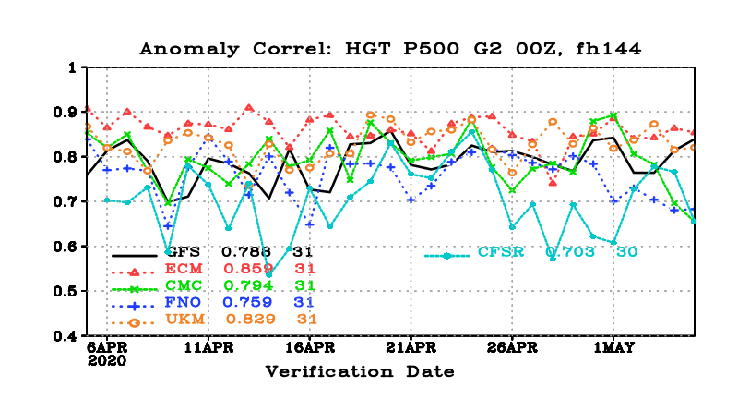
The Leading Global Centers Use 4DVAR
ECMWF
UKMET
CMC
And more…

Slide 54
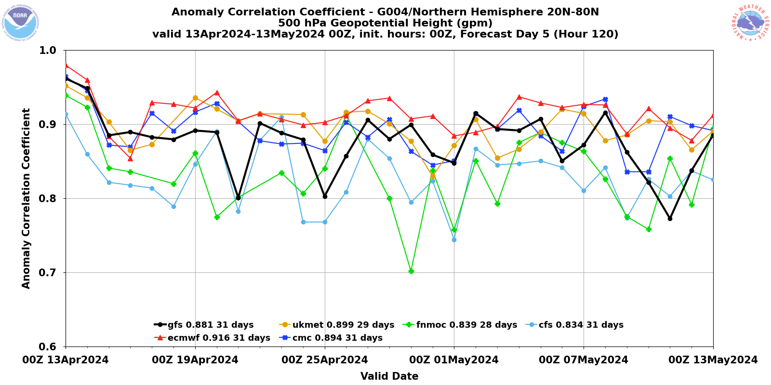

Slide 55
Ensemble-Based Data Assimilation
Virtually all major NWP centers run ensembles of many forecasts (e.g., GEFS at NOAA/NWS/NCEP)
Can use ensembles to do data assimilation.
Many of the new assimilation systems use ensemble data assimilation…along with GSI or 4DVAR
Ensembles can provide correlations between variables and between surrounding grid points

Slide 56
Remember this? Ensembles can help do this better

Slide 57
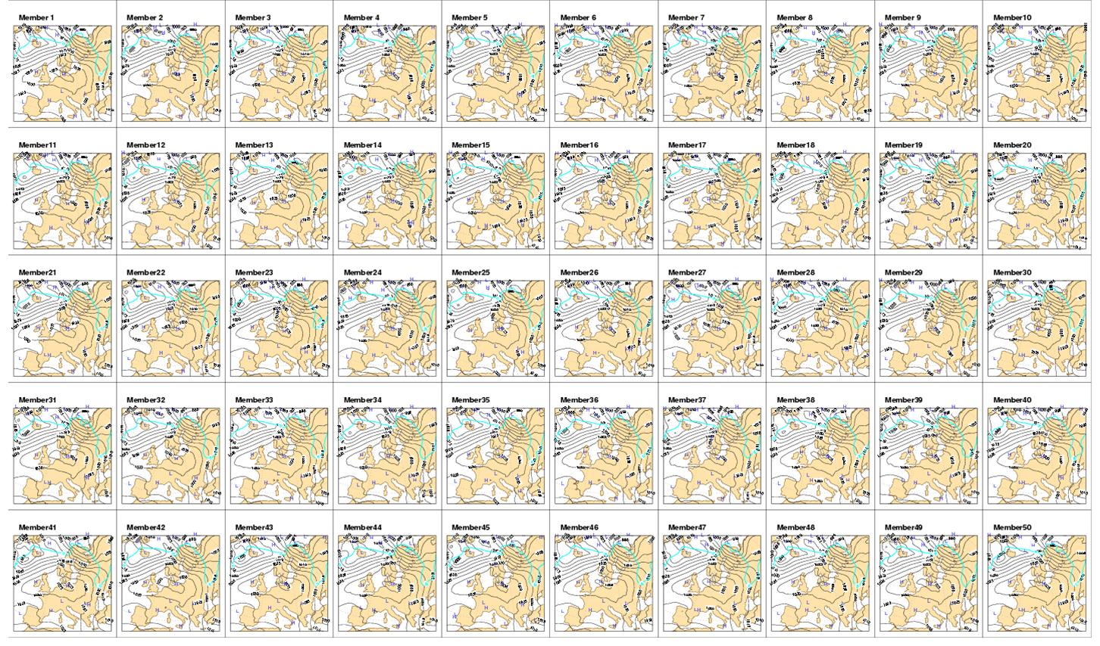

Slide 58
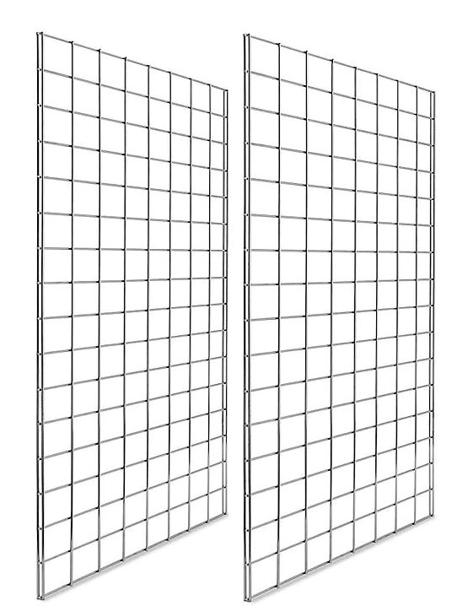
Multiple Grids at One Time Can Allow You to Calculate Correlations Between Grid Points
Multiple Values at a point
Can compute correlation between them
Values at another grid point
Different ensemble members at some time

Slide 59
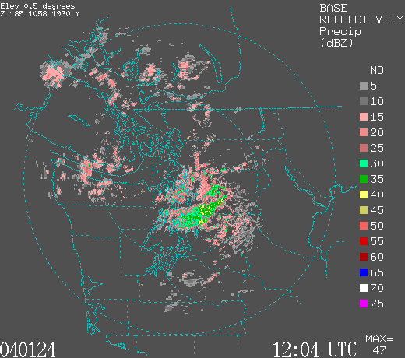
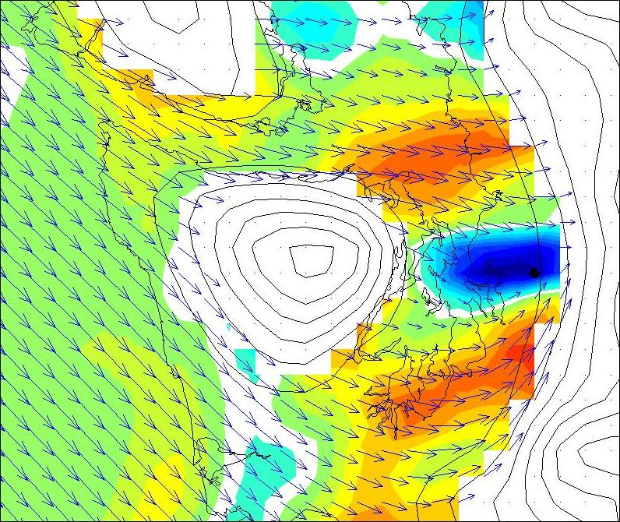
Mesoscale Covariances From An Ensemble
12 Z January 24, 2004
Camano Island Radar
|V₉₅₀|-q_{r} covariance

Slide 60
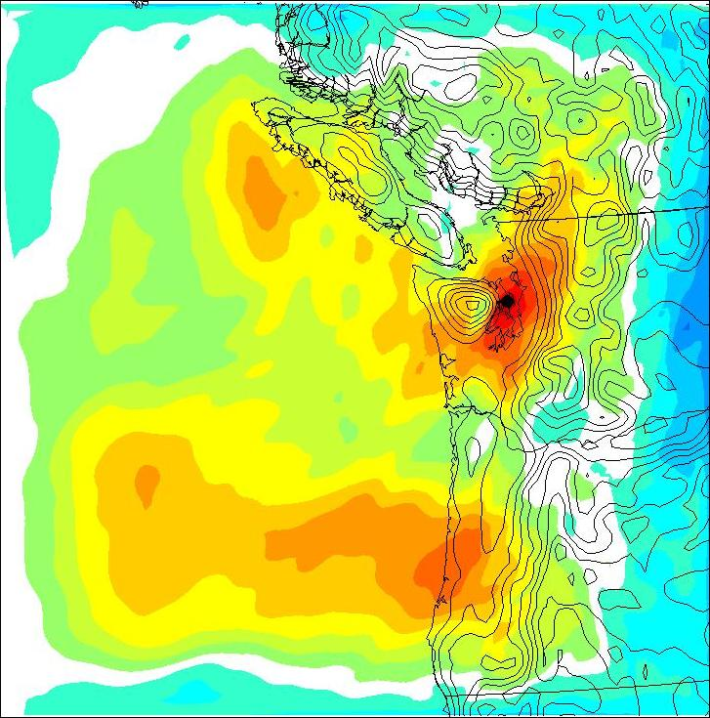
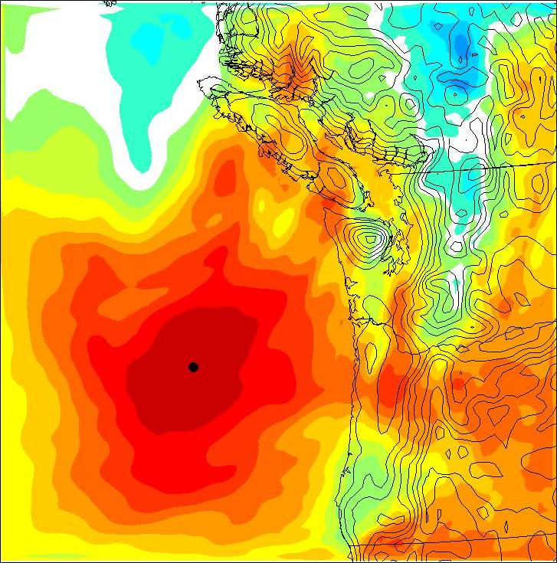
Surface Pressure Covariance from Ensembles
Land
Ocean

Slide 61
Ensemble Can Produce More Physical Covariances
Temperature observation
3DVAR
Ensemble-based

Slide 62
Hybrid Data Assimilation: Now Used in GFS
Uses 3DVAR/GSI and ensemble-based spatial covariances
Uses covariances from the relatively large GFS ensemble in 3DVAR to spread out “innovations” or alterations of the analysis

Slide 63
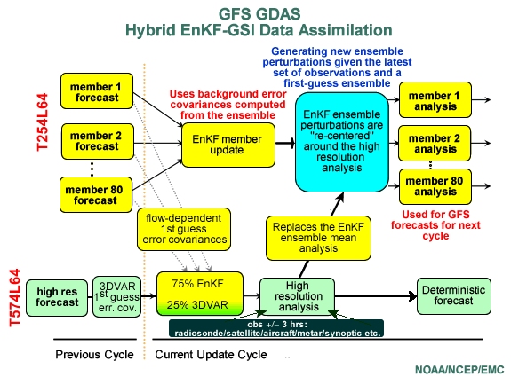

Slide 64
Latest NCEP Advance: ENVAR
Use ensemble-based temporal covariances to spread impact of observations over TIME.
Alternative to 4DVAR
Now operational.
Has some of the properties of 4DVAR (adjusts to model evolution)
Does not use the tangent linear or adjoint model.
Not as good as 4DVAR

Slide 65
Model Initialization
Objective analysis/data assimilation produces the model initialization: a physically consistent 3D description of the atmosphere at a specific time.
We are now ready for the next step: Model Integration

Slide 66
Model Integration Requires the Initialization Plus:
Basic dynamical equations (primitive equations)
Model physics, including parameterizations
Methods for solving the equations numerically
Computer resources

Slide 67
Represents an initial value problem, in which the solution to a time-dependent set of differential equations depends on the initial state.

Slide 68
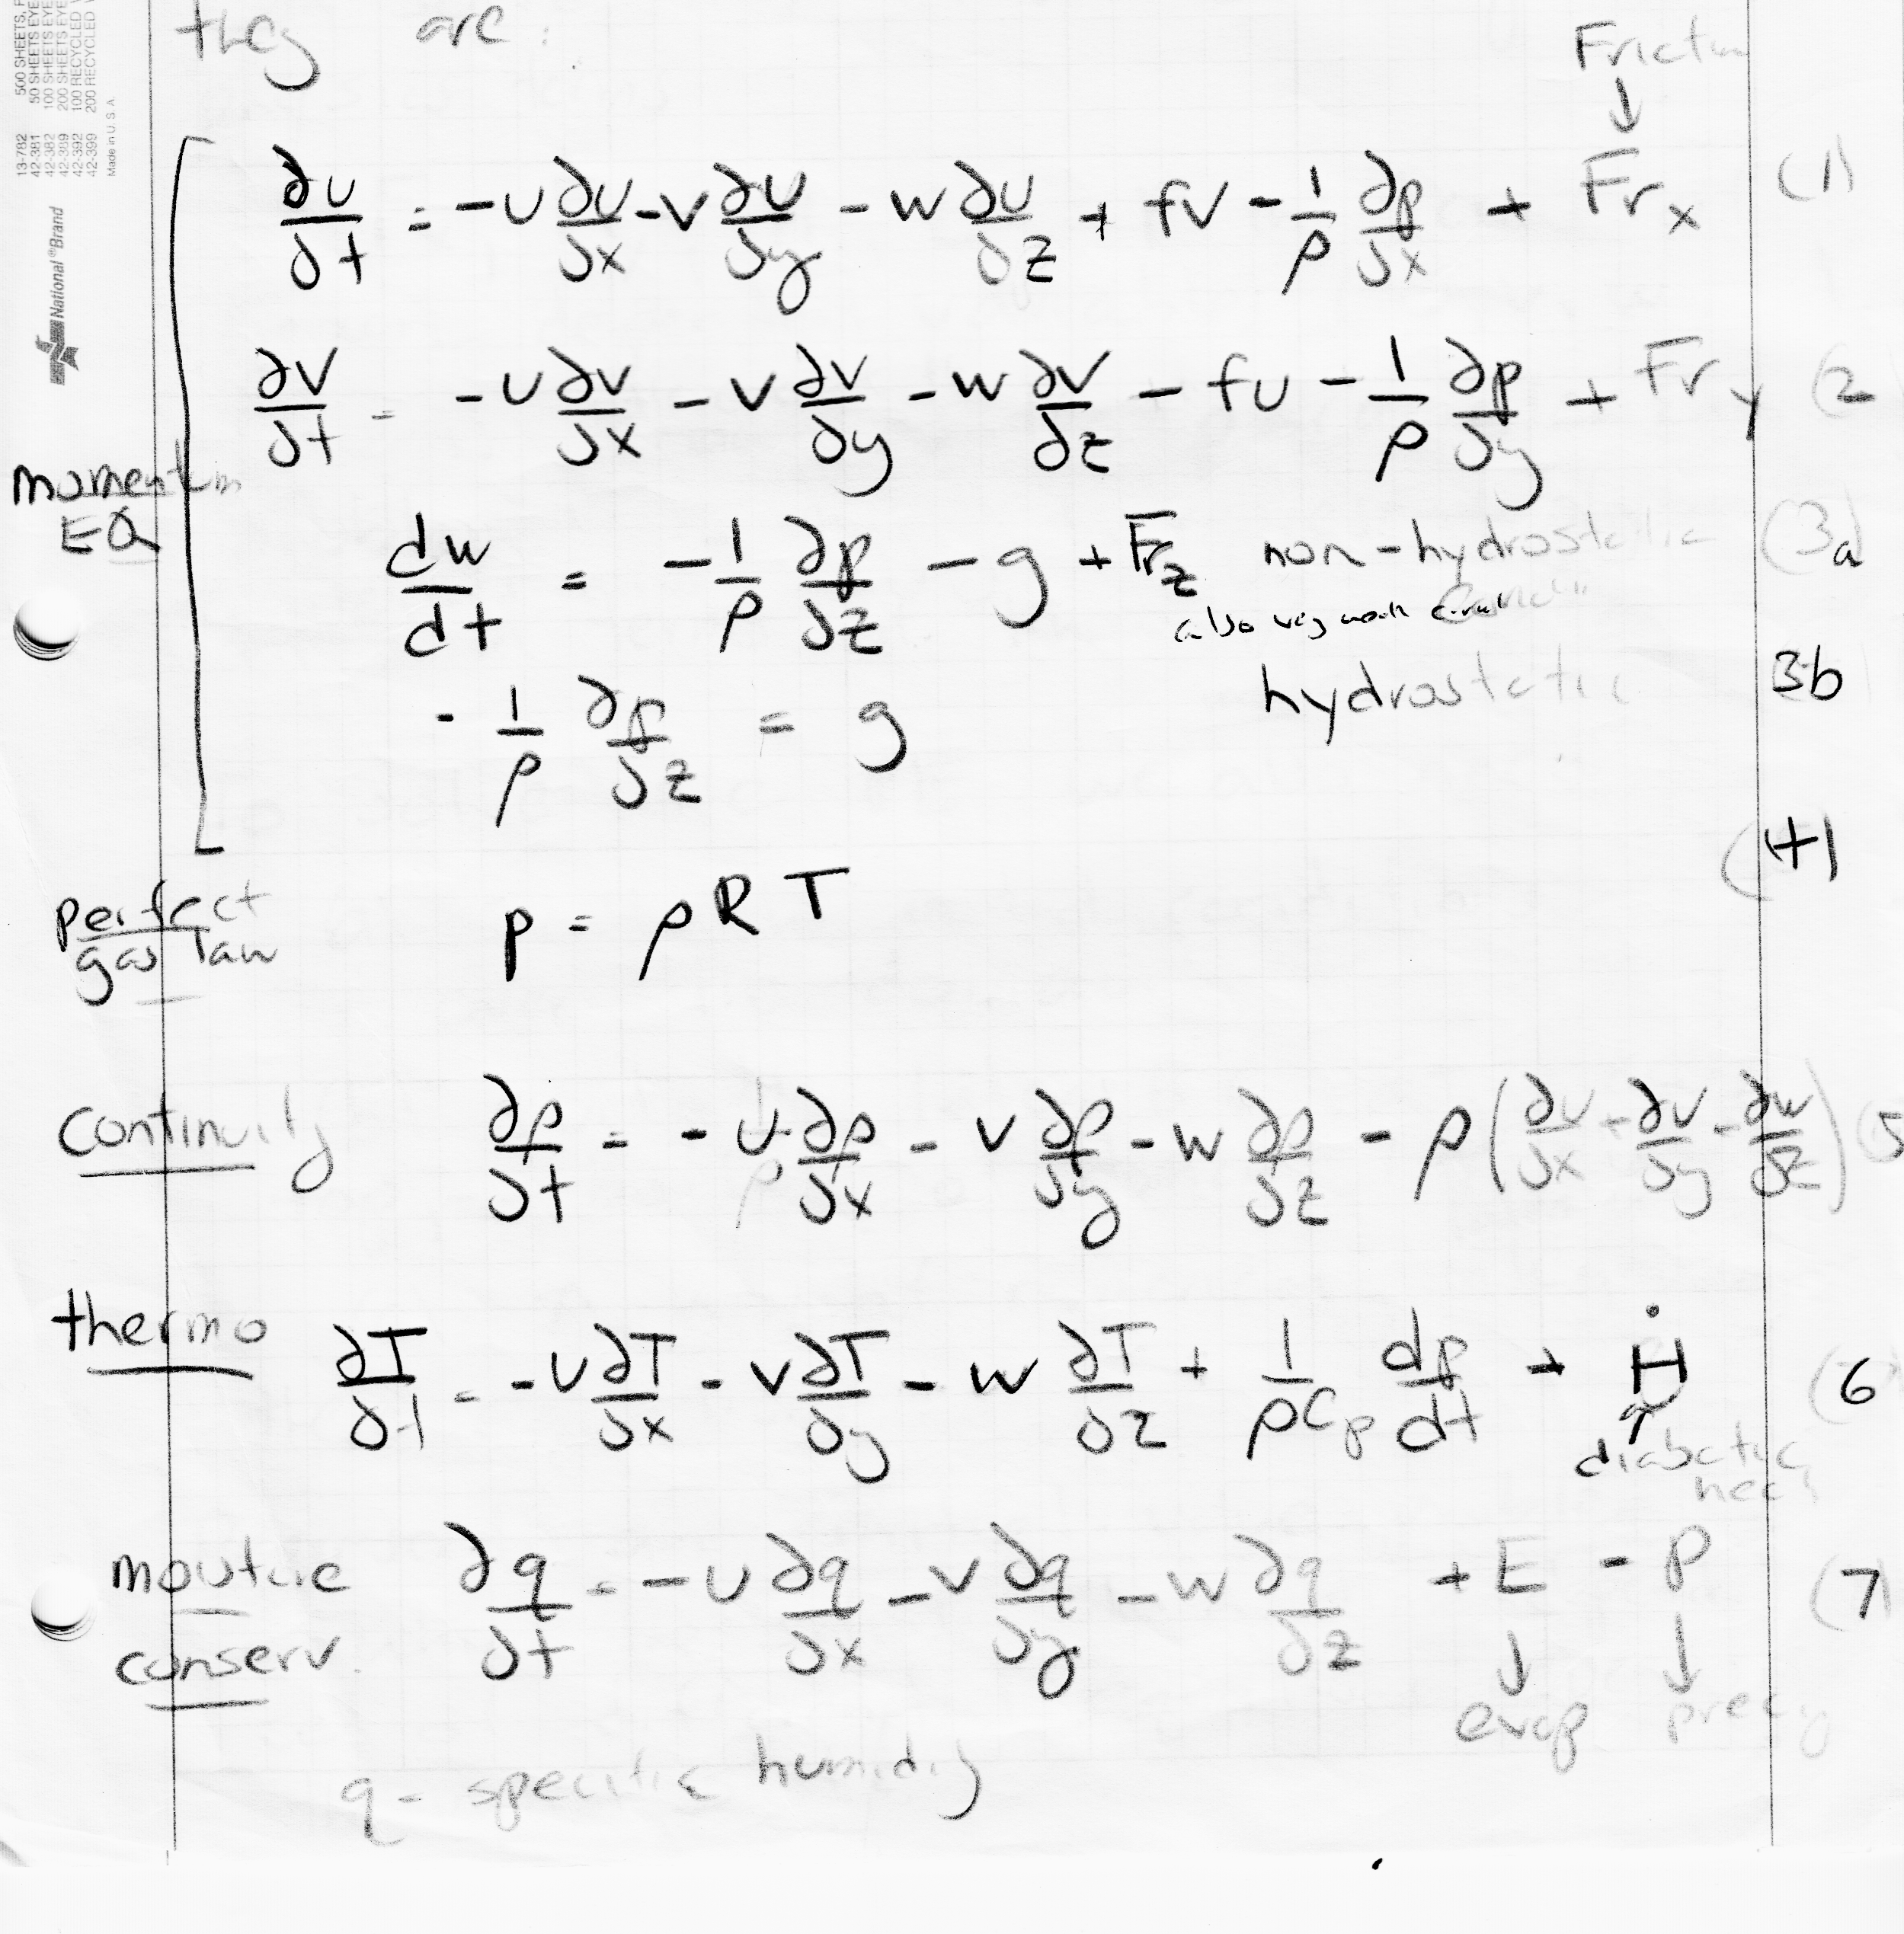
Modern NWP Models Are Based on the Primitive Equations:
Conservation Laws for Mass, Momentum, Energy, and Moisture

Slide 69
Primitive Equations
There are 7 equations and 7 unknowns/dependent variables: u, v, w, T, q, ρ, p
Can solve this if we can express physics terms in terms of known dependent variables (u, v, w, …). Physics terms include:
F_{x}, F_{y}, H, E, P
Expressing physics terms in terms of resolved dependent variables is an example of parameterization.

Slide 70
To Solve the Model Equations We Also Need
Suitable initial conditions over the domain
Suitable lateral BC at sides, top, and bottom of domain (no lateral BC for global model)
A way of numerically integrating the equations, including a suitable grid structure and an approach to solving the differential equations.

Slide 71
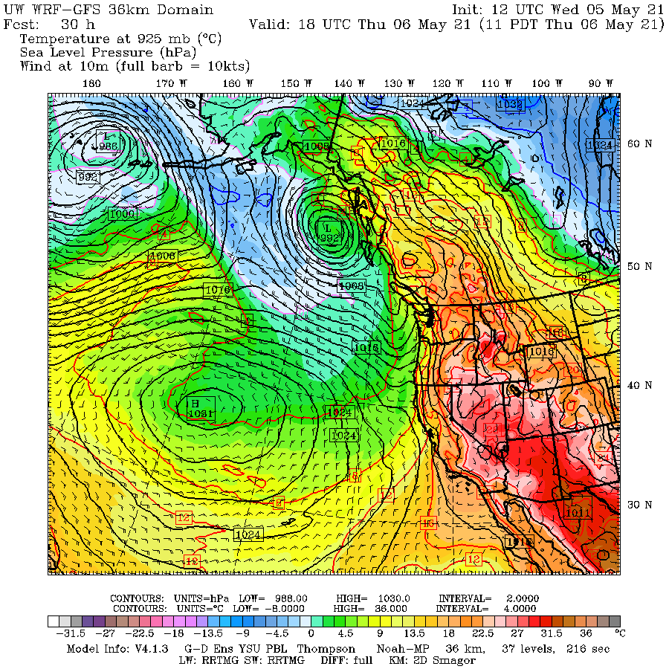
A limited domain simulation required lateral boundary conditions

Slide 72
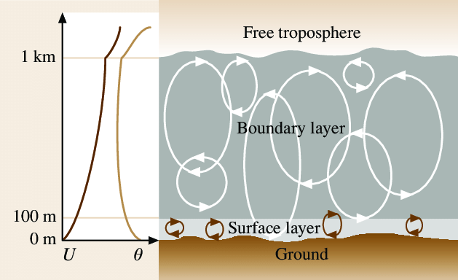
Physics Terms and Parameterizations: Friction or Drag Example
F_{x}, F_{y}: friction or drag. The key physics is the vertical transport of momentum by turbulent eddies. Associated with slowing winds in lower atmosphere.
Most important near the surface but can be large in wind shear layers aloft (e.g., clear air turbulence)

Slide 73
Friction or Drag Due to Turbulent Eddies
Models can simulate these eddies if they have sufficient resolution (~10-50 m grids)—known as LES (Large Eddy Simulation) models.
But with typical grid spacings of 3-20 km today, need to parameterize in terms of larger-scale variables.

Slide 74
Friction or Drag Due to Turbulent Eddies
Example of parametrization of surface drag, Bulk Formula used at the surface:
  |F| = a C_{d}|V|² , where a is constant and C_{d} is the drag coefficient, |F| is drag vector, V is velocity.

Slide 75
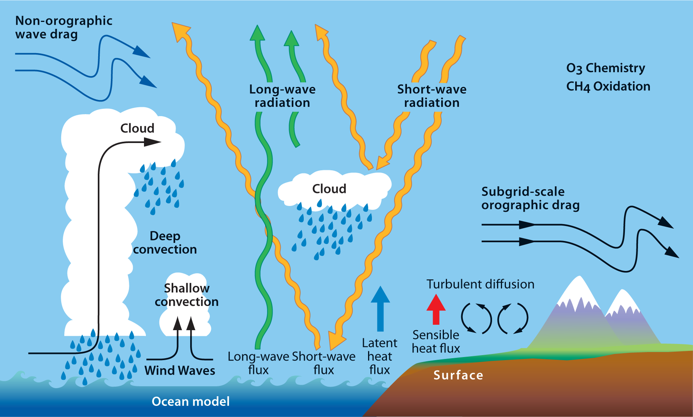
Diabatic Heating and Cooling, H
H = H_{L} + H_{C}+ H_{r} +H_{s}
H_{L}: latent heating/cooling due to large-scale ascent and descent
H_{c}: Latent heating/evaporative cooling associated with convection
H_{R}: Heating and cooling due to radiation
H_{s}: Sensible heat flux at the surface

Slide 76
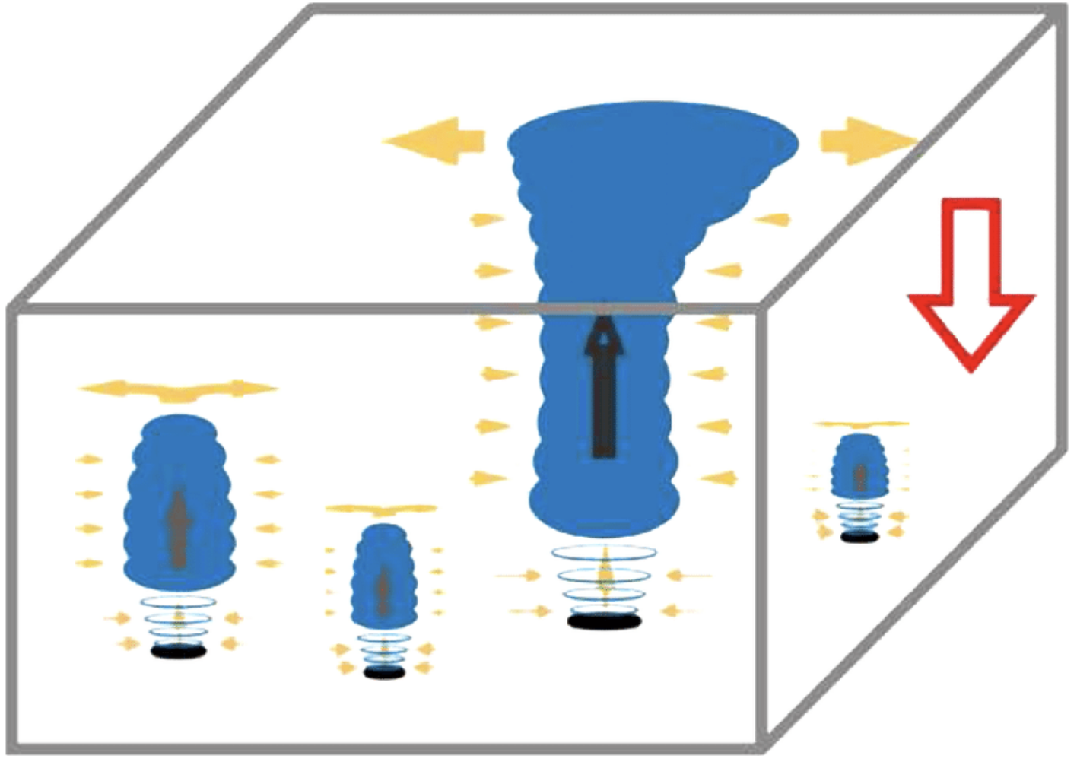
Problem
H_{c} is a subgrid-scale process
Occur on scales too small for model to resolve.
Need to parameterize it.

Slide 77
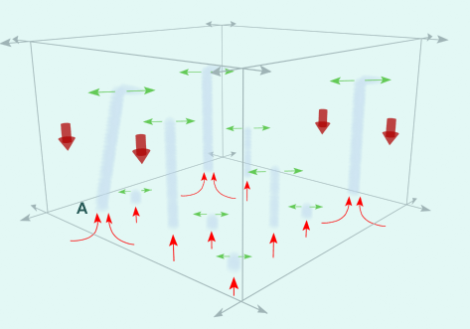
Convective Parameterization
Express sub-grid scale convective processes in terms of the large-scale dependent variables available on the model grid.

Slide 78
Convective Parameterization
Consider a model with a grid size of 12 km.
Cannot resolve thunderstorms directly or simulate their effects explicitly.
But we can’t ignore them!
Thunderstorms have huge effects on the atmosphere:
  Precipitation
  Vertical moisture and momentum flux
  Changes atmosphere stability

Slide 79
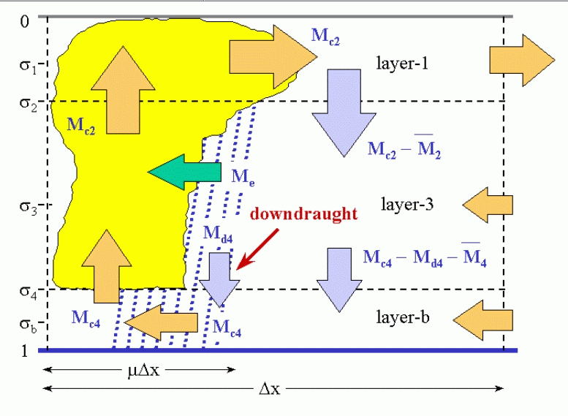
Can’t Neglect Effects of Convection!

Slide 80
Convective Parameterization
Relate the impacts of convection to the value of the dependent variables on the grid.
Example of the simplest (and earliest) parameterization—Kuo Parameterization
H_{c} α L_{mc} (large scale moisture convergence) and L_{vl} (large scale vertical lapse rate)
(H_{c}, diabatic heating due to convection)

Slide 81
Kuo Parameterization: The Simplest of All
H_{c} = a L_{mc}L_{vl} , a is constant.
_{Makes intuitive sense.}
Convection is dependent on a large vertical lapse rate, Lvl. Precipitation and convection aided by low-level moisture convergence Lmc
T₂
T₁

Slide 82
More Physics Terms That Need Parameterization!
P = P_{L} + P_{c}
  P_{L} is large-scale precipitation, P_{c} is convective precipitation. P is total precipitation. P_{c} can be acquired from convective parameterization.
E = E_{s} + E_{p}
  E_{s} is the evaporation from the surface, E_{p} is evaporation of precipitation. Each of these have convective and high-resolution components.

Slide 83
Many Parameterizations!
Parameterization of convection
Parameterization of planetary boundary layer processes: PBL parameterizations
Parameterizations of cloud/precipitation physics
Parameterizations of mountain wave drag from small gravity waves.

Slide 84
Hundreds of Parameterizations
Consider WRF
https://www2.mmm.ucar.edu/wrf/users/physics/phys_references.html

Slide 85
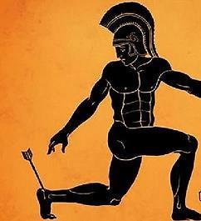
Parameterizations are the achilles heal of NWP

Slide 86
The Future of Parameterizations
Some parameterizations will go away with higher resolution models: e.g., deep convective parameterizations. Need to get to 4-km grid spacing or better.
PBL parameterization are needed until we get down to 20-50 m grid spacing (very, very far into the future)
Newest approach: machine-learning based parameterizations.

Slide 87
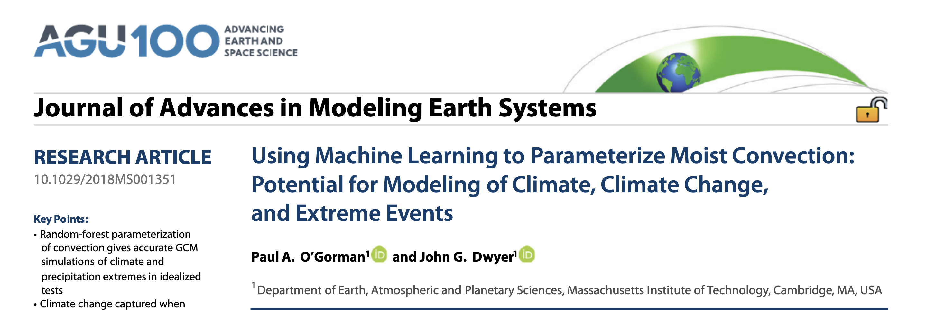

Slide 88
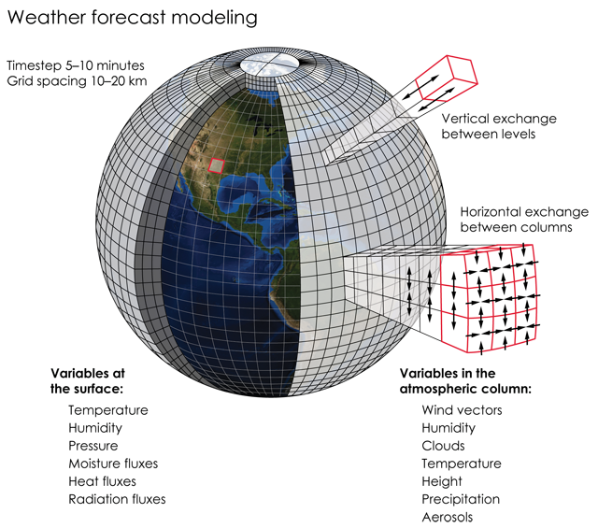
Representation of model variables

Slide 89
Grid Point Models (Dominant approach)
Horizontal (and vertical) variations described on a 3-D grid
Finite differences used for derivatives.
More accurate derivatives for smaller Δx (grid point spacing)
Effective resolution is ~ 6Δx
So a model using 10 km grid spacing can only effectively deal with weather phenomena of 60 km or better

Slide 90
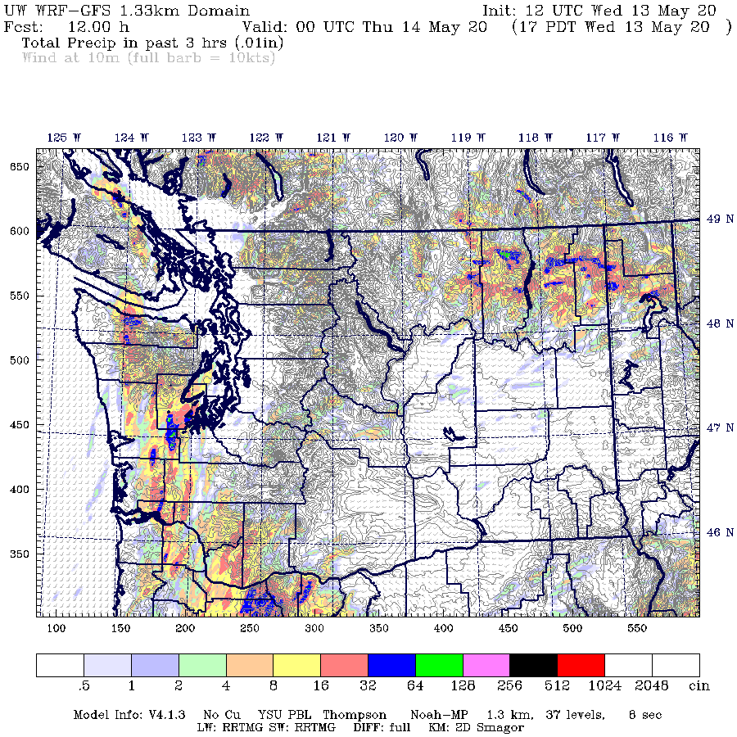
So 1.3 km UW WRF and only deal with features of scale greater than ~ 8 km!

Slide 91


Finite Differences to Approximate Derivatives
$\frac{∂f}{ðx}=(f\left(x+∆x\right)−f(x−∆x)$)/2$∆$x)
Centered Difference

Slide 92

Question: What Grid Spacing Needed to Get Flow Correct in Columbia Gorge?

Slide 93

Hint

Slide 94
If 4 km across and you need 6 grid points, then 4/6 km—2/3 km grid spacing

Slide 95

444.4 m grid spacing, Pass Height = 100 m
Portland
Troutdale
Cascade Locks
Notes:
Min pass height is at far right of domain near Cascade Locks (same place as 4/3 domain)
This plot is from 310 m. Note, vortex. See this on radar data too. Zoomed in plot will be from 150 m

Slide 96

T at
150 m
Surface
Portland
Troutdale
Notes:
Min pass height is at far right of domain near Cascade Locks (same place as 4/3 domain)
This plot is from 310 m. Note, vortex. See this on radar data too. Zoomed in plot will be from 150 m
Recall mesoscale plots. Good T and wind agreement.

Slide 97

Time Steps
Models need finite differences to calculate time derivatives.
Instead of Δx there is a Δt.
The model is integrated forward in small time steps (Δt).
The smaller the time steps the more calculations are needed for a certain period.

Slide 98



Slide 99
Courant–Friedrichs–Lewy (CFL) Criterion
Models experience computational instability when time step is too long for the grid spacing used.
  CFL stability criterion:
    cΔt/Δx <=1
c is phase speed of wave or disturbance
Implication: increase horizontal resolution, must decrease time step.
Double resolution, must half time step. Twice as many times steps over a period.

Slide 100

Believe it or not….if you halve the grid spacing…doubling the model spatial resolution, you need EIGHT TIMES more computer resources

Slide 101

Double the resolution
Imagine is you go from 100 to 50 km grid spacing for a region of 100 km square
The number of grid points from four to nine
100 km
100 km

Slide 102
Double the resolution
So have 9/4 more grid points.
Now if you half the grid spacing, you must half the time step. So TWICE as many times steps.
So computational cost has increased by:
  2 * 9/4 = 4.5 times
But increasing horizontal resolution generally means you must increase vertical resolution. And often increased costs in parameterizations.
Bottom line: about 8 times more computer resource.

Slide 103

Why numerical weather prediction demands the largest supercomputers
Numerical weather prediction code is highly parallelized (runs on thousands or tens of thousands of processors simultaneously

Slide 104
Some Models Don’t Use Grids!

Slide 105

Galerkin Approach (e.g., spectral)
An alternative to representation of variables on a grid.
Represents variation of dependent variables (e.g., u, v, T) as a sum of basis functions.
Fourier analysis is an example
http://www.falstad.com/fourier/index.html

Slide 106


Old GFS and ECMWF Use Spherical Harmonics to Represent Variation in the Horizontal
Spherical Harmonics
Legendre Polynomials

Slide 107

Spherical Harmonics

Slide 108
Spectral Representation is on the way out
Does not facilitate massive parallelization of code.
Issues with physics and representation of physical fields.
FV3 is a grid-based model and replaced old GFS, which was a spectral model.
Future ECMWF model will be a grid-based model

Slide 109

Vertical Coordinate Systems
Originally constant p and z horizontal levels
They had a problem…Boundary conditions (BC) when the grid hit terrain!

Slide 110

So Why Not Solve the Problem By Having the Model Levels Parallel the Terrain?

Slide 111
Thus, was born the Sigma Coordinate System σ= p/p_{s}
The surface is σ =1 and values decreases aloft

Slide 112

Sigma Coordinate System
Can also be based on height (Sigma-Z)
σ= Z/Z_{s}

Slide 113
Hybrid Vertical Coordinate Systems
Sigma is good at low levels, but the waviness aloft can cause noise and other problems
The solution are hybrid vertical coordinates: sigma at low levels gradually changing to a relatively horizontal coordinate aloft (e.g., pressure, height, potential temperature-theta)

Slide 114

Sigma-Theta

Slide 115
New Sigma-P in WRF
Old Sigma
Sigma P

Slide 116
Most models today use some sort of sigma coordinate system

Slide 117
How Many Model Levels Needed?
Model levels are generally not placed uniformly in the vertical
Usually more near surface and near tropopause, where large vertical gradients occur.
Need to have more vertical levels with higher horizontal resolution

Slide 118


Slide 119

UW WRF

Slide 120

Nesting of Model Grids

Slide 121
Why Nesting?
Could run a high-resolution model over the whole globe, but that would require huge amounts of computational resources.
Alternative is to only use high resolution where you need it…nesting is one approach.
In nesting, a smaller-sized higher resolution domain is embedded with a larger, lower-resolution domain.

Slide 122




Slide 123


Slide 124




UW WRF Nesting
36 km
12 km
4 km
4km

Slide 125
Model Nesting
Can be one-way or two way. In one way, the outer grid feeds the inner grid.
Can also have adaptive nests that will put more resolution where it is needed.
  Example are higher resolution grids following hurricanes
Also stretched grids, providing more resolution where needed.

Slide 126


Slide 127
Next Generation Global Model Grid Structures
Have varying resolutions in one grid structure
Avoid have separate nested domains

Slide 128

MPAS: Hexagonal Shapes that Vary in Size!

Slide 129

MPAS

Slide 130

FV3-Replacement for GFS

Slide 131

FV-3 has cubed sphere geometry

Slide 132

Cube Sphere Grid

Slide 133
Major U.S. Global Model Overview
Global Models
  Global Forecast System Model (GFS). Uses FV-3 model. 13 km grid spacing, 127 levels. Run out to 384 hr, four times per day. ENVAR data assimilation
  Navy Global Environmental Model (NAVGEM). 180 hour, four times a day. 50 levels, 19 km grid, 4DVAR
  UKMET Unified Model, used by U.S. Air Force. They call it the Global Air-Land Weather Exploitation Model (GALWEM). 17-km grid. 70 levels, 4DVAR
  IBM-MPAS- only private sector firm doing operational global modeling. Down to 3 km grid spacing in some regions.

Slide 134
Major International NWP Centers
ECMWF: European Center for Medium-Range Weather Forecasting. The Gold Standard. Their global model is considered the best. 9 km resolution, 4DVAR
UK Met Office Unified Model: An excellent global model slightly superior to GFS, 10 km, 4DVAR
Canadian Meteorological Center, 4DVAR
Australia, Taiwan, France, Germany and other lesser centers

Slide 135
Global Forecast System (GFS) Model
Now V16
Previous called the Aviation (AVN) and Medium Range Forecast (MRF) models.
Grid point FV-3 model, 127 levels
Run four times a day to 384 hr (16 days!).
Major increase in skill during past decades derived from using direct satellite radiance in the 3DVAR/Hybrid EnKF/3DVAR analysis scheme and other satellite assets.
13 km grid spacing over the first 10 days of the model forecast and 27 km from 10 to 16 days (384 hours). Thus, it now essentially a global mesoscale model

Slide 136
GFS
Vertical coordinates are hybrid sigma/pressure… sigma at low levels to pressure aloft.
ENVAR data assimilation (not 4DVAR)

Slide 137



Slide 138
GFS Data Assimilation (GDAS)
Global analysis every 6 hr
Has a later data cut-off time than the mesoscale models…and thus can get a higher percentage of data.
Uses much more satellite assets than NAM..thus improve global analysis and forecasts.
Hybrid Data assimilation (ENVAR)

Slide 139

In addition to the high resolution GFS, there is a lower resolution GFS ensemble called GEFS
25 km grid space equivalent
31 members
Stochastic physics to help produce diversity
16 days

Slide 140

What is stochastic physics?
Model physics parameterizations have uncertainties
For example, uncertainties in parameters and constants.

Slide 141
Stochastic Physics
Why not vary the physics parameters within reasonable limits?
One can also add random perturbations to the net effects of the physics terms (such as varying net heating slightly)
Stochastic physics can add physics uncertainty, which can be large.

Slide 142
Global Model Verification
GFS is not the best global model

Slide 143


Slide 144


Slide 145


Slide 146


Slide 147


Slide 148


Slide 149

Higher Resolution Operational Models

Slide 150
Major U.S. High-Resolution Mesoscale Models (all non-hydrostatic)
WRF-ARW (developed at NCAR)
NAM-NMM-B (developed at NCEP Environmental Modeling Center)-NAM stands for North American Mesoscale run
COAMPS (U.S. Navy)
RAMS (Regional Atmospheric Modeling System, Colorado State)
ARPS (Advanced Regional Prediction System): Oklahoma
US Air Force/Army: Uses UKMET Unified Model

Slide 151

Mesoscale Model History

Slide 152
Operational Mesoscale Model History in US
Early: LFM, NGM (history)-70s, 80s (120-150 km)
Eta 80s, 90s.
MM5: Still used by some, but mainly phased out. 80s, 90s
NMM- Main NWS mesoscale model, updated Eta model. Sometimes called WRF-NMM and NAM. 90s (40 km)
WRF-ARW: Heavily used by research and some operational communities. Late 90s, 20’s
NMM replaced by NMM-B (called NAM). Early 2000s
FV3

Slide 153
WRF (Weather Research and Forecasting) Model
Developed at NCAR (National Center for Atmospheric Research) in late 1990s.
Also called WRF ARW (Advanced Research WRF)
Non-hydrostatic, grid point model
Excellent numerics, huge collection of physics options
Used here at the UW!

Slide 154


Slide 155

The NCAR ARW WRF Model:
(See: www.wrf-model.org)
Terrain-following hybrid vertical coordinate
Two-way nesting, any ratio
Conserves mass, entropy and scalars.
Very wide range of physics options

Slide 156

WRF
Thousands of users around the world
Relatively easy to learn and use

Slide 157
Historical Note
Before WRF there was MM5 (Mesoscale Model 5) that was developed by NCAR
First, generally available mesoscale model (first available ~1982)
Another early model developed at the same time was RAMS (Regional Atmospheric Mesocale Model) developed at Colorado State. Favorite of air quality community.

Slide 158
NMM-B also called NAM (North American Mesoscale) Model
Hybrid sigma-pressure vertical coordinate
60 levels
12-km grid spacing outer domain
Through 84h for most domains
Forced by GFS on boundaries.
Main regional model used by NWS offices

Slide 159

NAM Domain

Slide 160
NMM-B Nests
One-way nested forecasts computed concurrently with the 12-km NMM-B parent run for
  CONUS (4 km to 60 hours)
  Alaska (6 km to 60 hours)
  Hawaii (3 km to 60 hours)
  Puerto Rico (3 km to 60 hours)
  For fire weather, moveable 1.33-km CONUS and 1.5-km Alaska nests are also run concurrently (to 36 hours).
  Call them HRW-High Resolution Windows

Slide 161

NMMB 4-km Conus

Slide 162
NCEP NAM
Generally less skillful than GFS, even over U.S.
Generally inferior to WRF-ARW at same resolution (more diffusion and smoothing, worse numerics)

Slide 163


Slide 164


Slide 165

“In general, NAM had the worst performance not only for model skill but also for spatial feature attributes as a result of the existence of large dry bias and location errors. The finer resolution of NAM did not offer any advantage in predicting small-scale storms compared to the coarser GFS. WRF had a large advantage for high precipitation thresholds”

Slide 166


Navy COAMPS (Coupled Ocean/Atmosphere Mesoscale Prediction System)
Sigma-Z
Coupled Atmosphere and Ocean

Slide 167

Coupled Ocean is Important for the Navy

Slide 168

http://www.nrlmry.navy.mil/coamps-web/web/home

Slide 169

U.S. Air Force Uses UKMET Unified Model (GALWEM)

Slide 170


Slide 171
U.S. Rapid Refresh NWP
A Powerful Tool For Nowcasting
Two Resolutions:
RAP: 13 km
HRRR: 3 km

Slide 172


Slide 173
Rapid Refresh (RR) A.K.A RAP (also RUC) and HRRR
The goal is to assimilate and use the rapidly increasing array of off-time or continuous observations (not a 00 and 12 UTC world anymore!
Want very good analyses and very good short-term forecasts EVERY HOUR
The RUC/RR ingests and assimilates data hourly, and then makes short-term forecasts

Slide 174
NOAA/NWS Rapid Refresh
Currently uses the WRF ARW model…
Resolution: Rapid Refresh: 13 km and 50 levels, High Resolution Rapid Refresh (HRRR, 3 km)
Will switch to FV-3 this year. Will be called RRFS

Slide 175


Slide 176

RAP
HRRR

Slide 177

Rapid Refresh: 13 km with larger domain

Slide 178

High-Resolution Rapid Refresh: 3 km, 1 hr, smaller domain

Slide 179
Observations Used
Hourly Observations | RAP 2013 N. Amer
Rawinsonde (T,V,RH) | 120
Profiler – NOAA Network (V) | 21
Profiler – 915 MHz (V, Tv) | 25
Radar – VAD (V) | 125
Radar reflectivity - CONUS | 1km
Lightning (proxy reflectivity) | NLDN, GLD360
Aircraft (V,T) | 2-15K
Aircraft - WVSS (RH) | 0-800
Surface/METAR (T,Td,V,ps,cloud, vis, wx) | 2200- 2500
Buoys/ships (V, ps) | 200-400
GOES AMVs (V) | 2000- 4000
AMSU/HIRS/MHS radiances | Used
GOES cloud-top press/temp | 13km
GPS – Precipitable water | 260
WindSat scatterometer | 2-10K

Slide 180


Slide 181

Huge Number of Output Fields
Particularly Useful for Convective Forecasting and Short-Term Prediction
https://rapidrefresh.noaa.gov/hrrr/HRRRnew/

Slide 182

New Addition: HRRR Smoke!

Slide 183
Online Access to HRRR

Slide 185

http://www.spc.noaa.gov/exper/hrrr/

Slide 186

Concerns about the switch to RRFS (WRF to FV-3 cores): Intense point storms and more

Slide 187


Slide 188


Slide 189
A Palette of Models
Forecasters have many models to look at.
They vary by:
  Region simulated
  Resolution
  Model Physics
  Data used in the assimilation/initialization process
The diversity of models can be a very useful tool to a forecaster.

Slide 190
Accessing NWP Models
The department web site (go to weather loops or weather discussion) provides easy access to many model forecasts.
The Department Regional Prediction Page gets to the department regional modeling output.
http://www.atmos.washington.edu/mm5rt/
The NCEP web site is good place to start for NWS models. https://mag.ncep.noaa.gov/

Slide 191

http://mag.ncep.noaa.gov/

Slide 192

Tropical Tidbits https://www.tropicaltidbits.com/analysis/models/

Slide 193

Alicia Bentley’s Webpage http://www.atmos.albany.edu/student/abentley/realtime.html

Slide 194
RTMA
(Real Time Mesoscale Analysis System)
NWS Mesoscale Analysis System for verifying model output and human forecasts.
Hourly Mesoscale Analyses

Slide 195


Slide 196


Slide 197
Real-Time Mesoscale Analysis RTMA
Downscales a short-term NAM or RR forecast to fine-resolution terrain and then uses observations to produce a fine-resolution analysis.
RTMA uses mesonet data, which is of highly variable quality due to variations in sensor siting and sensor maintenance
Either a 5-km or 2.5 km analysis.

Slide 198
Why does NWS want this?
Gridded verification of their gridded forecasts (NDFD)
Serve as a mesoscale Analysis of Record (AOR)
For mesoscale forecasting and studies.
https://mag.ncep.noaa.gov/observation-type-area.php#

Slide 199


Slide 200


Slide 201
The End

